Slide 1
SQLite Database

Slide 2
Why we should use a database?
fast: can search/filter a database very quickly compared to a file
big: scale well up to very large data sizes
safe: built-in mechanisms for failure recovery (transactions)
common syntax: database programs use SQL language

Slide 3
SQLite
SQLite is a software library. SQLite implements an SQL database engine that has the following characteristics:
Self-contained (requires no other components)
Serverless (requires no server backend)
Zero-configuration (does not need to be configured for your app)

Slide 4
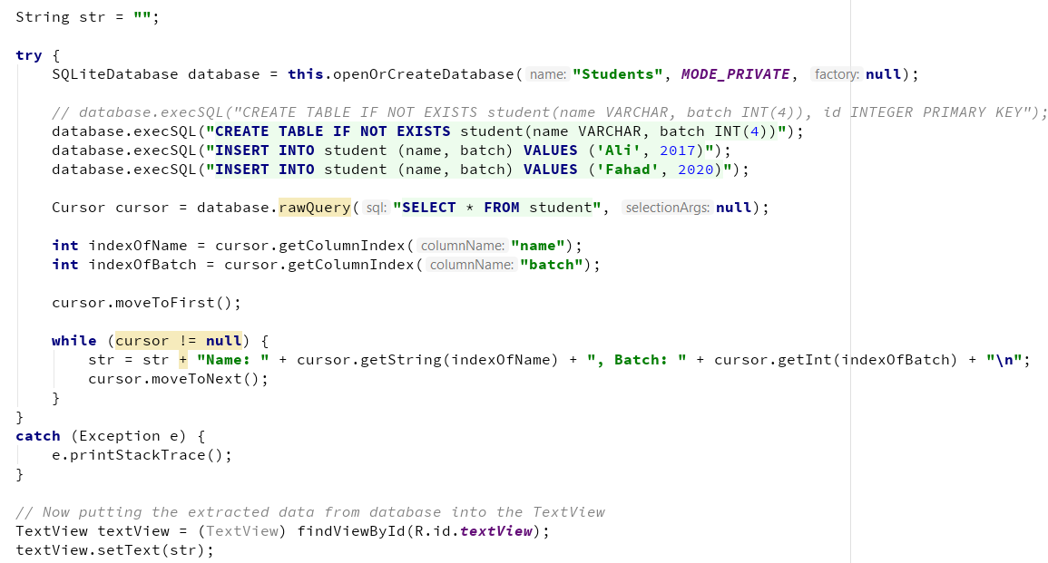
SQLite Example Code

Slide 5
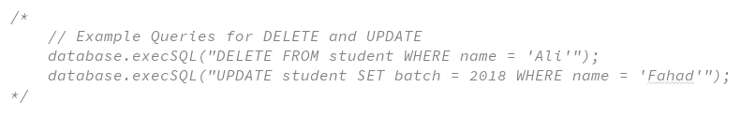
SQLite Example Code for DELETE and UPDATE

Slide 6
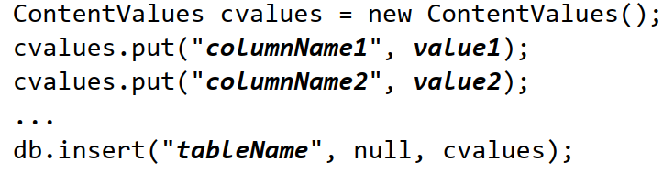
SQLite INSERT using ContentValues
ContentValues can be optionally used as a level of abstraction for statements like INSERT, UPDATE
meant to allow you to use cleaner Java syntax rather than raw SQL syntax for some common operations.

